Slide 1
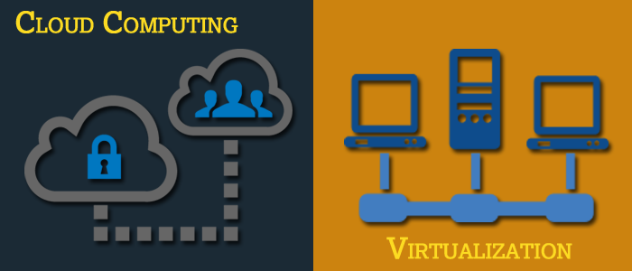
Basics of Virtualization and Cloud Technology

Slide 2
Chapter 5: Cloud Delivery Models and its Challenges

Slide 3
Cloud Delivery Models and its Challenges
Cloud Computing Delivery Models
Obstacles for Cloud Technology
Cloud Vulnerabilities
Cloud Challenges
Practical Applications of Cloud Computing

Slide 4
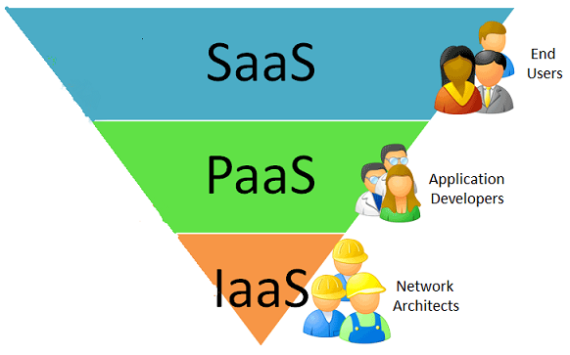
Cloud Computing Delivery Models
Why cloud delivery models?
Cloud delivery models are continuing to evolve as business drivers push more organizations towards a more globally distributed infrastructure. Many companies are actively moving parts of their environments into the cloud for more efficiency, agility and capabilities around growth. This is a major push which has helped data centers come to the forefront of the technological evolution and has allowed more organizations to leverage their services. Costs are coming down and the environments supporting the cloud are becoming more stable.

Slide 5
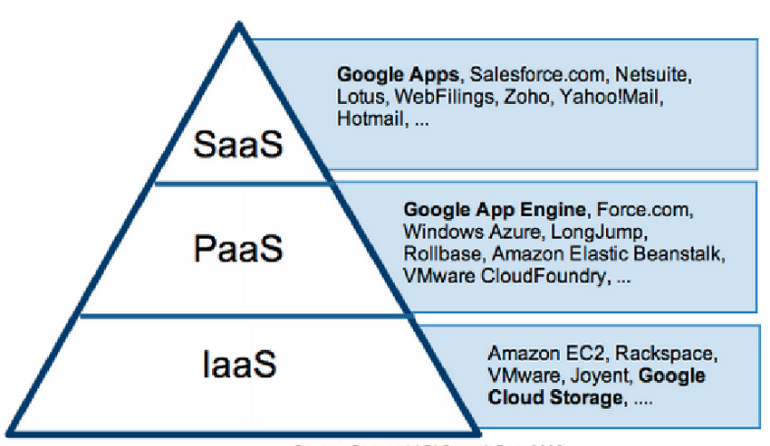
Cloud Delivery Models contd..
A cloud delivery model represents a specific, pre-packaged combination of IT resources offered by a cloud provider. Three common cloud delivery models have become widely established and formalized
Infrastructure-as-a-Service (IaaS)
Platform-as-a-Service (PaaS)
Software-as-a-Service (SaaS)

Slide 6
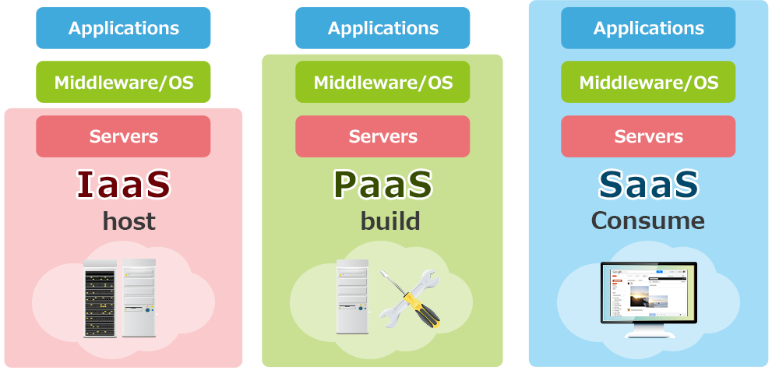
Infrastructure-as-a-Service (SaaS)
Infrastructure as a Service (IaaS) is a way of delivering Cloud Computing infrastructure such as servers, storage, network and operating systems as an on-demand service. Rather than purchasing servers, software, datacenter space or network equipment, clients instead buy those resources as a fully outsourced service on demand
Characteristics of IaaS
IaaS is generally accepted to comply with the following;
Resources are distributed as a service
Allows for dynamic scaling
Has a variable cost, usage based pricing model (pay per go and pay per use)
Has multitenant architecture, includes multiple users on a single piece of hardware
IaaS typically has enterprise grade infrastructure

Slide 7
Where IaaS Makes Sense
IaaS makes sense in a number of situations and these are closely related to the benefits that Cloud Computing bring. Situations that are particularly suitable for Cloud infrastructure include;
Where demand is very volatile – any time there are significant spikes and troughs in terms of demand on the infrastructure
For new organizations without the capital to invest in hardware
Where the organization is growing rapidly and scaling hardware would be problematic
Where there is pressure on the organization to limit capital expenditure and to move to operating expenditure
For specific line of business, trial or temporary infrastructural needs

Slide 8
Where IaaS May Not be the Best Option
While IaaS provides massive advantages for situations where scalability and quick provisioning are beneficial, there are situations where its limitations may be problematic.
Examples of situations where we would advise caution with regards IaaS include;
Where regulatory compliance makes the offshoring or outsourcing of data storage and processing difficult
Where the highest levels of performance are required, and on-premise or dedicated hosted infrastructure has the capacity to meet the organization’s needs

Slide 9
IaaS Classifications:
Private, Public and Hybrid Cloud (Cloud classification is based on the basis of the resting infrastructure)
Private Cloud: IaaS on a private network dedicated for a company or a group of companies deployed inside the firewall of them. Analogy of a private cloud is a ‘Company cab’. Private Cloud is considered as a most secured IaaS offering.
Public Cloud: IaaS service deployed over the internet; for firms to pay and use the service. Analogy of a public cloud is the utility services such as electricity, gas and water.
Hybrid Cloud: a combination of both – private cloud and public cloud in an organization.

Slide 10
IaaS Vendors
Leading IaaS vendors include:
Rackspace
Verizon
Amazon AWS
Savvis
GoGrid
VMware vCloud
Flexiscale
Joyent IaaS
Rightscale
Eucalyptus
BlueLock's IaaS
Enomaly
SoftLayer
IBM Cloudburst
Oracle Cloud Services

Slide 11
Platform-as-a-Service (PaaS)
Platform as a service (PaaS) is a cloud computing model in which a third-party provider delivers hardware and software tools usually those needed for application development to users over the internet. A PaaS provider hosts the hardware and software on its own infrastructure. As a result, PaaS frees users from having to install in-house hardware and software to develop or run a new application.

Slide 12
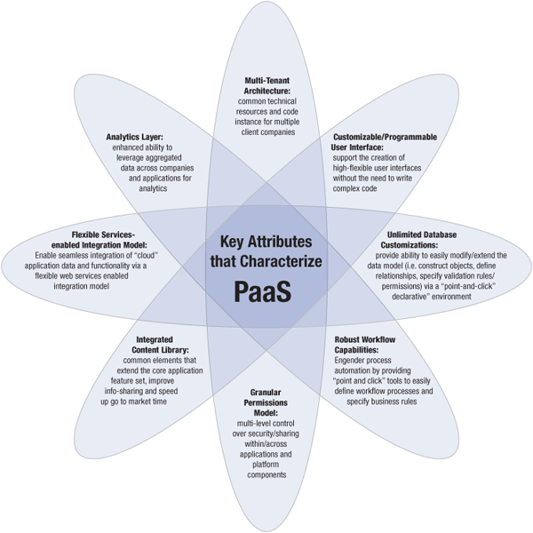
Characteristics of PaaS
Source: https://ronnie05.files.wordpress.com/2013/05/paas.png
Notes:
Key attributes of PaaS
Multi-tenant architecture
Multi-tenant architecture is one of the key elements of PaaS model. A multi-tenant platform is one that uses common resources and a single instance of both the object code of an application as well as the underlying database to support multiple customers simultaneously. Although the technology stack in a multi-tenant deployment is shared, customers’ user experience should be comparable to that of a customer using an application developed and managed by dedicated resources. The complexity of this delivery model presents a challenge to develop and deliver reliable, scalable, and secure applications where customer interactions and data are logically isolated from one another. However, multi-tenant deployment of an application leverages the economies of scale through the use of a limited set of computing resources, and lower associated deployment, upgrade, support and maintenance costs across a large number of customers. The multi-tenant architecture offers providers enhanced ability to mine aggregated data and, in turn, respond faster to usage trends as well as to develop additional enhancements for users1 .
2. Customizable/Programmable User Interface
The PaaS offering should provide the ability to construct highly-flexible user interfaces via a simple “drag & drop” methodology which permits the creation and configuration of UI components on the fly. In order to jump start the construction of user interfaces/ displays, pre-defined standard UI components should be available that can be assembled in building-block fashion with minimal coding. For further customization of the UI which may be necessary to accommodate specific user requirements, there should be the option to easily leverage/invoke a tag library of other complementary, more sophisticated, re-usable UI components (i.e. grids, tree-like hierarchies, etc) through simple HTML code without the need of writing complex code. Furthermore given the growing set of internet-enabled web devices, additional flexibility to use other web technologies such as CSS, AJAX and Adobe Flex to specify the appearance of the application’s interface should be available to the UI designer. The PaaS offering must afford UI designers/developers complete fine-grained control to shape the presentation of data to a specific context – for example: displaying the data in one format when viewed on a hand-held device and in another format when viewed in a desktop web browser. This “drag & drop” paradigm of constructing user interfaces, an essential capability of a robust PaaS offering provides UI designers/developers with better control over the appearance of the application’s interface and permits the creation of new and sophisticated presentation layers quickly and easily without requiring much custom coding.
3. Unlimited Database Customizations
Data persistence is core to many applications and facilitating the creation, configuration and deployment of persistent objects without requiring programming expertise is a key characteristic of a powerful “cloud platform”. Thus, the PaaS offering must support the construction of objects, the definition of relationships between the objects and the configuration of advanced data behavior all from within the comfort of the web browser via a “point and click’ declarative paradigm. As opposed to a relational database where tables are used to store data, objects constitute the fundamental building blocks for “cloud-based” applications. Through a declarative web interface that provides complete visual control at the meta-data level, application designers/developers should be able to define objects along with the fields/attributes that determine what kind of data is stored within each object record. Specifying relationships between objects, a key requirement of any sophisticated business application, must be possible through the declarative web-based interface as well. Besides supporting the definition of 1) objects, 2) the fields that constitute the object and 3) the relationships between the objects, the ability to incorporate validation rules, permissions at the object/field level as well as the ability to specify auditing behavior must all be possible via a declarative web-based paradigm.
4. Robust Workflow engine/capabilities
Successful business process execution via process automation is the primary objective of any business application. A “cloud-platform” must offer a business-logic engine that supports the definition of workflow processes and the specification of business rules to engender process automation. A workflow process defines the different statuses a business object flows through during its life cycle. Workflow actions drive the object through different statuses within the context of a workflow process and can be triggered either through human intervention (i.e. assuming that the user has the required permission to execute/invoke the action) or an event (i.e. the creation of a specific object record). Using a combination of workflow processes, statuses, actions, events and the rules that govern actions, the application designer should be able to model almost any kind of business process using point-and-click tools within the web browser. In addition to providing a declarative fashion to model sophisticated business conditions and application behavior, the PaaS offering must offer the ability to programmatically define powerful trigger conditions using a scripting language such as JavaScript.
5. Granular control over security/sharing (permissions model)
Granular secure access to appropriate data is one of the counterstone of the PaaS model. Just within the PaaS model, secure access models might span multiple logical domains. For example, the application permission model defines access within a specific application such as basic user, user group, managers, or an administrator, to access to specific areas within the application such as standard and premium features, or areas with sensitive and non-sensitive dat. Cross-application and cross-company permission models control access and enable collaboration between the different applications accessible to a single company or legal entity. Additionally, these models manage access control of the organization that manages the platform itself. Further levels of access granularity are achieved by allowing users, or virtual entities to access specific components within PAAS based on their source. For example, it is possible to control what data is accessible depending on where the party is accessing it from2 . Some of the challenges of the granular security model include managing the complexity of the data and access segmentation, auditing the anomalies of the data access and data utilization. These models lie outside and above the standard security components such as firewalls, secure access protocols, authentication models and are not specific to the PAAS model as such.
6. Flexible “services-enabled” integration model
Platform-As-A-Service facilitates the rapid construction of applications in the cloud by providing the necessary foundational elements such as data persistence and workflow capabilities that are core/essential to the creation of any business application. However given the complex IT environments that permeate most enterprises today, the PaaS offering should leverage Service Oriented Architecture (SOA) principles to enable seamless integration of “cloud” application data and functionality residing in the “cloudplatform” with other on-premise/on-demand systems and applications. At a minimum, the PaaS offering must support a flexible integration model enabled via both SOAP and REST API calls. The respective web-services based API’s should provide standard CRUD (create, read, update, delete) methods as well as search, binary file upload/download methods for working with file and image fields, methods for working with relationships, and a method for retrieving a full XML representation of an object definition and all of its components. The API’s must adhere to the same permissions and access control restrictions that have been specified via the security model.
7. Analytics layer
One of exciting elements of PaaS is having access to the aggregated model. This affords a much richer opportunity for data analytics across the companies utilizing a single application, across applications, and across the companies using multiple applications. The ability to harness this opportunity provides access into utilization trends, feedback about the usage, insights into application interoperability, allows for better planning on the resource expansions, and offers additional avenues for innovation. However, it is important to keep in mind that the custodial data itself is typically the property of the client companies, and only the aggregated trend/utilization data might have the ability to be used for analysis. Privacy is often cited as a top concern when it comes to protecting strategic business know-how and preventing the exposure of proprietary data and the identities of users within a specific PaaS application company.
8. Integrated content library
PaaS makes it possible to leverage a wide array of common content and application elements that facilitate information sharing, collaboration, training, online business, sales, lead tracking, access control, audits, integrated logging, share communication library, centralized security model, automated sign-up wizards, and a notification system among others4 . Common tagging and search functionality across all the application components and data could potentially be enabled as well5 . By itself, a single standalone application not deployed on PaaS generally lacks these powerful integrated components. A company seeking to use these services might tap into multiple separate applications and as a result lose the ability to integrate the data centrally, increase security risk by having to log in and maintain separate identities and data across multiple vendors.

Slide 13
Characteristics of PaaS contd..
Services to develop, test, deploy, host and maintain applications in the same integrated development environment. All the varying services needed to fulfil the application development process
Web based user interface creation tools help to create, modify, test and deploy different UI scenarios
Multi-tenant architecture where multiple concurrent users utilize the same development application
Built in scalability of deployed software including load balancing and failover
Integration with web services and databases via common standards
Support for development team collaboration – some PaaS solutions include project planning and communication tools
Tools to handle billing and subscription management

Slide 14
Where PaaS Makes Sense
PaaS is especially useful in any situation where multiple developers will be working on a development project or where other external parties need to interact with the development process. As the case study below illustrates, it is proving invaluable for those who have an existing data source – for example sales information from a customer relationship management tool, and want to create applications which leverage that data. Finally PaaS is useful where developers wish to automate testing and deployment services.
The popularity of agile software development, a group of software development methodologies based on iterative and incremental development, will also increase the uptake of PaaS as it eases the difficulties around rapid development and iteration of software.
Some examples of PaaS include Google App Engine, Microsoft Azure Services, and the Force.com platform.

Slide 15
Where PaaS May Not be the Best Option
Where the application needs to be highly portable in terms of where it is hosted
Where proprietary languages or approaches would impact on the development process
Where a proprietary language would hinder later moves to another provider – concerns are raised about vendor lock-in
Where application performance requires customization of the underlying hardware and software

Slide 16
Software as a Service
Software as a service (SaaS) is a software distribution model in which a third-party provider hosts applications and makes them available to customers over the Internet.
Characteristics of SaaS
Web access to commercial software
Software is managed from a central location
Software delivered in a “one to many” model
Users not required to handle software upgrades and patches
Application Programming Interfaces (APIs) allow for integration between different pieces of software

Slide 17
Where SaaS Makes Sense
Applications where there is significant interplay between the organization and the outside world. For example, email newsletter campaign software
Applications that have a significant need for web or mobile access. An example would be mobile sales management software
Software that is only to be used for a short term need. An example would be collaboration software for a specific project
Software where demand spikes significantly, for example tax or billing software used once a month
SaaS Examples: Google Apps, Salesforce, Workday, Concur, Citrix GoToMeeting, Cisco WebEx

Slide 18
Where SaaS May Not be the Best Option
Applications where extremely fast processing of real time data is required
Applications where legislation or other regulation does not permit data being hosted externally
Applications where an existing on-premise solution fulfils all of the organization’s needs

Slide 19
Comparison of Cloud Computing Delivery Models
Table: Comparison between cloud computing delivery models
Category | Characteristics | Vendor and Products | Advantages
IaaS | Consumers are provided with virtualized hardware and storage on top of which they can build their infrastructure | Amazon Web Services (AWS), Google Compute Engine (GCE), Microsoft Azure, Rackspace, Cisco Metapod | scalability, Pay per use, no investment in physical infrastructure, location independence
PaaS | Consumers are provided with a platform for developing applications hosted in the cloud | AWS Elastic Beanstalk, Google App Engine (GAE), Windows Azure, Apache Stratos | server software, storage, tools for design and development, server-side scripting environment
SaaS | Consumers are provided with applications that are accessible anywhere and anytime | Salesforce, Google Apps, Citrix GoTo Meeting, Cisco WebEx | compatibility, automatic updates and patch management, easier administration

Slide 20



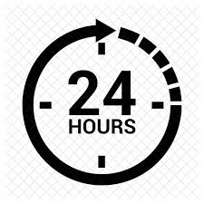
Obstacles for Cloud Technology
Four big obstacles to cloud computing
Security
Legislation Integration
Availability
Notes:
Security
Security is the first thing that leaps to mind when you start thinking about putting data online.
Before you export all of your company accounting data into the latest and greatest online accounting package, you need to take a few things into consideration:
Transport Layer Security: Traditional forms of encryption for internet traffic are under attack and are no longer completely reliable
Software Auditing: All software used to provide access to the service needs to be audited and maintained against vulnerabilities. This includes web server software, middleware application layer software such as PHP or .NET, all libraries used, database software, the actual code for the service, JavaScript code (because we all love Web 2.0), administrative service software, operating system etc.
Data Storage Security: We need to know that our data is actually stored in a secure way, that is not accessible to other users of the service or to any Joe Soap that walks into a hosting facility, and that also has protection from hardware failures etc.
Personnel Security: What level of auditing of personnel is performed by the provider? How much access do they have to actual data? What access controls, deprovisioning methods, and account management facilities are in place?
Decommissioning Strategy: What happens when hardware containing sensitive data is removed from service? Can you be sure that your data is properly wiped from hard disks when they fail? What happens to your data when you decide to discontinue a service or migrate to an alternate service?
Legislation
Legal practices are increasingly using cloud computing as an alternative to 'traditional' IT provision. Cloud computing has a number of advantages, but it also carries risks which your firm should navigate carefully.
Usually very tied up with the security problems, is a problem with regard to legislation. This is such a difficult area that many companies just pretend it isn’t an issue, however you need to consider not only your own country’s legislation with regard to the storage of data and the export of information, but also the laws regarding the same for the country of your provider. So if you are doing business in India, and you decide to make use of a cloud-based service in the US, all of your data is immediately subject to US law. This has very big implications and adds another layer of complexity, which is usually a compliance issue with regard to data protection. If your business is storing credit-card information, or personal user data such as health information, you need to ensure that that data is stored in a way that meets your own country’s legal requirements, but the requirements of your provider which might be located in a different country may not be the same. This means that you have to ensure that the legal requirements, or at least actual practices by your provider, actually match your own legal needs.
Finally, there are issues around intellectual property and data ownership. While it should seem obvious that the data is owned by the customer making use of a service, the way in which data is store and accessed usually falls to the service provider.
Integration
While cloud vendors will be quick to tell you how much money you will save using their services, exporting different facilities out onto the internet has a different associated cost that is very hard to measure, and this is the cost of integration.
Firstly, you need to consider that it is unlikely that you will be able to move every bit of your IT infrastructure into the cloud in one go. That means that existing facilities need to be integrated with online facilities so that you can keep the same, or at least very similar, business processes to those that you already have in place.
Since every business is different in terms of the software and services that they make use of, and how these pieces of infrastructure are tied together, it is unlikely that a vendor will meet your exact needs. Usually, this either requires a change to your business processes or to your current infrastructure, potentially requiring some custom development to make things work smoothly.
Perhaps the most commonly highlighted problem is that of Identity Management.
In the good old days if an employee left your company, simply revoking their account would be sufficient to prevent them from accessing facilities that they were not authorised to access. By moving different components of you IT infrastructure out into the cloud, you create something of an identity management crisis.
The problem here is that firstly, cloud vendors tend to be specific about the services they offer. That means that you might end up using a variety of different vendors for different services. This means that you have different accounts for your users hosted in a variety of different places. A user could end up with multiple passwords that need to be managed and different access rights depending on the services that they have connected to. This creates an administrative nightmare. If an employee leaves, there is no way to quickly check that access to all services has been removed.
There are movements to try to get a handle on this, such as Federation, but all of them are immature and pretty costly to implement, not to mention that you need to make sure that your cloud vendor is using the same technologies as you’re interested in using. As your infrastructure becomes increasingly distributed, the cost of integrating different components that allow your business to function smoothly increases as well.
Availability
Once upon a time in IT, employees just had to make sure that LAN (Local Area Network) connectivity was operational, and then all of the users could get on with their work. By moving services out onto the cloud, they become increasingly dependent on a chain of third parties in order to access business critical data.
Inside the business, users will still need the LAN to function with the same resilience that it always had, but now they will also need to be sure that there is guaranteed uptime not only for each of the services that use on the Cloud, but for your ISP (Internet Service Provider) as well.
While certainly it is possible that having services out on the cloud actually increase availability, since an ISP failure can easily be overcome by using an alternate ISP during an outage. By using cloud services, user can suddenly access business facilities via the mobile phone, tablet or laptop computer. Realistically, however, when the internet fails within most enterprise-sized businesses, results in down-time of the business

Slide 21
Cloud Vulnerabilities
When deciding to migrate to the cloud, following are the cloud vulnerabilities that should be considered:
Session Riding
Virtual Machine Escape
Reliability and Availability of Service
Insecure Cryptography
Data Protection and Portability
CSP Lock-in
Internet Dependency
Notes:
Session Riding: Session riding happens when an attacker steals a user’s cookie to use the application in the name of the user. An attacker might also use CSRF attacks in order to trick the user into sending authenticated requests to arbitrary web sites to achieve various things.
Virtual Machine Escape: In virtualized environments, the physical servers run multiple virtual machines on top of hypervisors. An attacker can exploit a hypervisor remotely by using a vulnerability present in the hypervisor itself – such vulnerabilities are quite rare, but they do exist. Additionally, a virtual machine can escape from the virtualized sandbox environment and gain access to the hypervisor and consequentially all the virtual machines running on it.
Reliability and Availability of Service: We expect our cloud services and applications to always be available when we need them, which is one of the reasons for moving to the cloud. But this isn’t always the case, especially in bad weather with a lot of lightning where power outages are common. The CSPs have uninterrupted power supplies, but even those can sometimes fail, so we can’t rely on cloud services to be up and running 100% of the time. We have to take a little downtime into consideration, but that’s the same when running our own private cloud.
Insecure Cryptography: Cryptography algorithms usually require random number generators, which use unpredictable sources of information to generate actual random numbers, which is required to obtain a large entropy pool. If the random number generators are providing only a small entropy pool, the numbers can be brute forced. In client computers, the primary source of randomization is user mouse movement and key presses, but servers are mostly running without user interaction, which consequentially means lower number of randomization sources. Therefore the virtual machines must rely on the sources they have available, which could result in easily guessable numbers that don’t provide much entropy in cryptographic algorithms.
Data Protection and Portability: When choosing to switch the cloud service provider for a cheaper one, we have to address the problem of data movement and deletion. The old CSP has to delete all the data we stored in its data center to not leave the data lying around.
Alternatively, the CSP that goes out of the business needs to provide the data to the customers, so they can move to an alternate CSP after which the data needs to be deleted. What if the CSP goes out of business without providing the data? In such cases, it’s better to use a widely used CSP which has been around for a while, but in any case data backup is still in order.
CSP Lock-in: We have to choose a cloud provider that will allow us to easily move to another provider when needed. We don’t want to choose a CSP that will force us to use his own services, because sometimes we would like to use one CSP for one thing and the other CSP for something else.
Internet Dependency: By using the cloud services, we’re dependent upon the Internet connection, so if the Internet temporarily fails due to a lightning strike or ISP maintenance, the clients won’t be able to connect to the cloud services. Therefore, the business will slowly lose money, because the users won’t be able to use the service that’s required for the business operation. Not to mention the services that need to be available 24/7, like applications in a hospital, where human lives are at stake.

Slide 22
Cloud Challenges
Cloud computing challenges have always been there. Companies are increasingly aware of the business value that cloud computing brings and are taking steps towards transition to the cloud. A smooth transition entails a thorough understanding of the benefits as well as challenges involved. Like any new technology, the adoption of cloud computing is not free from issues. Some of the most important challenges are as follows:
Security and Privacy
Interoperability and Portability
Reliability and Availability
Performance and Bandwidth cost
Notes:
SECURITY AND PRIVACY
The main challenge to cloud computing is how it addresses the security and privacy concerns of businesses thinking of adopting it. The fact that the valuable enterprise data will reside outside the corporate firewall raises serious concerns. Hacking and various attacks to cloud infrastructure would affect multiple clients even if only one site is attacked. These risks can be mitigated by using security applications, encrypted file systems, data loss software, and buying security hardware to track unusual behavior across servers.
It is difficult to assess the costs involved due to the on-demand nature of the services. Budgeting and assessment of the cost will be very difficult unless the provider has some good and comparable benchmarks to offer. The service-level agreements (SLAs) of the provider are not adequate to guarantee the availability and scalability. Businesses will be reluctant to switch to cloud without a strong service quality guarantee.
INTEROPERABILITY AND PORTABILITY
Businesses should have the leverage of migrating in and out of the cloud and switching providers whenever they want, and there should be no lock-in period. Cloud computing services should have the capability to integrate smoothly with the on-premise IT.
RELIABILITY AND AVAILABILITY
Cloud providers still lack round-the-clock service; this results in frequent outages. It is important to monitor the service being provided using internal or third-party tools. It is vital to have plans to supervise usage, SLAs, performance, robustness, and business dependency of these services.
PERFORMANCE AND BANDWIDTH COST
Businesses can save money on hardware but they have to spend more for the bandwidth. This can be a low cost for smaller applications but can be significantly high for the data-intensive applications. Delivering intensive and complex data over the network requires sufficient bandwidth. Because of this, many businesses are waiting for a reduced cost before switching to the cloud.

Slide 23
Cloud Challenges Contd..
13 biggest challenges when moving the business to the cloud according to Forbes Technology Council:
Getting it right
People and processes
Having a defined strategy and business objectives
Getting over the psychological barriers
Time, cost and security
Not getting caught up in the hype
Changing management
Dependable technological infrastructure
Accurately estimating the costs
Modifying the architecture of cloud services
Translating security posture to the cloud environment
Determining whether to lease or own
Connecting legacy systems with cloud applications
Source: https://www.forbes.com/sites/forbestechcouncil/2017/06/05/13-biggest-challenges-when-moving-your-business-to-the-cloud/#331431389b0e

Slide 24
Practical Applications of Cloud Computing
Cloud computing has been credited with increasing competitiveness through cost reduction, greater flexibility, elasticity and optimal resource utilization. Here are a few situations where cloud computing is used to enhance the ability to achieve business goals.
IaaS and PaaS delivery models
Public, private and hybrid cloud deployment models
Test and development
Big data analytics
File storage
Disaster recovery
Backup
Notes:
IaaS and PaaS delivery models
When it comes to IaaS, using an existing infrastructure on a pay-per-use scheme seems to be an obvious choice for companies saving on the cost of investing to acquire, manage and maintain an IT infrastructure. There are also instances where organizations turn to PaaS for the same reasons while also seeking to increase the speed of development on a ready-to-use platform to deploy applications.
Public, private and hybrid cloud deployment models
Among the many incentives for using cloud, there are two situations where organizations are looking into ways to assess some of the applications they intend to deploy into their environment through the use of a cloud (specifically a public cloud). While in the case of test and development it may be limited in time, adopting a hybrid cloud approach allows for testing application workloads, therefore providing the comfort of an environment without the initial investment that might have been rendered useless should the workload testing fail.
Another use of hybrid cloud is also the ability to expand during periods of limited peak usage, which is often preferable to hosting a large infrastructure that might seldom be of use. An organization would seek to have the additional capacity and availability of an environment when needed on a pay-as you-go basis.
Test and development
Probably the best scenario for the use of a cloud is a test and development environment. This entails securing a budget, setting up your environment through physical assets, significant manpower and time. Then comes the installation and configuration of your platform. All this can often extend the time it takes for a project to be completed and stretch your milestones.
With cloud computing, there are now readily available environments tailored for your needs at your fingertips. This often combines, but is not limited to, automated provisioning of physical and virtualized resources.
Big data analytics
One of the aspects offered by leveraging cloud computing is the ability to tap into vast quantities of both structured and unstructured data to harness the benefit of extracting business value.
Retailers and suppliers are now extracting information derived from consumers’ buying patterns to target their advertising and marketing campaigns to a particular segment of the population. Social networking platforms are now providing the basis for analytics on behavioral patterns that organizations are using to derive meaningful information.
File storage
Cloud can offer you the possibility of storing your files and accessing, storing and retrieving them from any web-enabled interface. The web services interfaces are usually simple. At any time and place you have high availability, speed, scalability and security for your environment. In this scenario, organizations are only paying for the amount of storage they are actually consuming, and do so without the worries of overseeing the daily maintenance of the storage infrastructure.
There is also the possibility to store the data either on or off premises depending on the regulatory compliance requirements. Data is stored in virtualized pools of storage hosted by a third party based on the customer specification requirements.
Disaster recovery
This is yet another benefit derived from using cloud based on the cost effectiveness of a disaster recovery (DR) solution that provides for a faster recovery from a mesh of different physical locations at a much lower cost that the traditional DR site with fixed assets, rigid procedures and a much higher cost.
Backup
Backing up data has always been a complex and time-consuming operation. This included maintaining a set of tapes or drives, manually collecting them and dispatching them to a backup facility with all the inherent problems that might happen in between the originating and the backup site. This way of ensuring a backup is performed is not immune to problems such as running out of backup media , and there is also time to load the backup devices for a restore operation, which takes time and is prone to malfunctions and human errors.
Cloud-based backup, while not being the panacea, is certainly a far cry from what it used to be. You can now automatically dispatch data to any location across the wire with the assurance that neither security, availability nor capacity are issues.

Slide 25


